Slide 1
Implementation of Wireless Sensor Network for soil NPK analysis using Cubic Spline Method
Present By-
1.Arjun Yachwad(B194032)
2.Prashant Walunj(B194158)
3.Mangesh Gund(B194048)
4.Chaitanya Barsawade(B198040)
Guide By
Prof. Santosh Warpe

Slide 2
Content
Introduction
Aim & Objectives
Problem statement
System Architecture
Modules & its implementation
Project Results
Conclusion
References

Slide 3
Problem Statement
Implementation of Wireless Sensor System for Soil NPK analysis using Cubic Spline Method. To provide optimum use of fertilizer to a specific crop in the field and get maximum profit.

Slide 4
Introduction
As agriculture plays a major part for economical development of India, Soil is a complex medium that contains minerals, organic matter, micro-organisms, air and water.
Over-fertilization results in groundwater pollution or toxic accumulation of chemicals in the soil.
The aim of this experiment is to adjust fertilization based on crop needs and soil properties and to reduce the amount of fertilizer in soil without diminishing yield.
To improve productivity and proﬁt margin, adaptation of new technologies can help us at great extent.
We propose the system with Wireless Sensor Network for NPK monitoring using sensor nodes.
This system present study and analysis of Wireless Sensor Network that applied in agriculture for automated farming.

Slide 5
Aim & Objectives
Aim-
To understand the importance of soil fertility.
To study the essential nutrients in plant growth.
Objectives-
To determine the level of availability of nutrients or the need for its introduction
To provide a basis for fertilizer recommendations for a given crop.
To evaluate the fertility status of the soil and plan a nutrient management program.
To provide an index of nutrient availability or supply in a given soil.

Slide 6
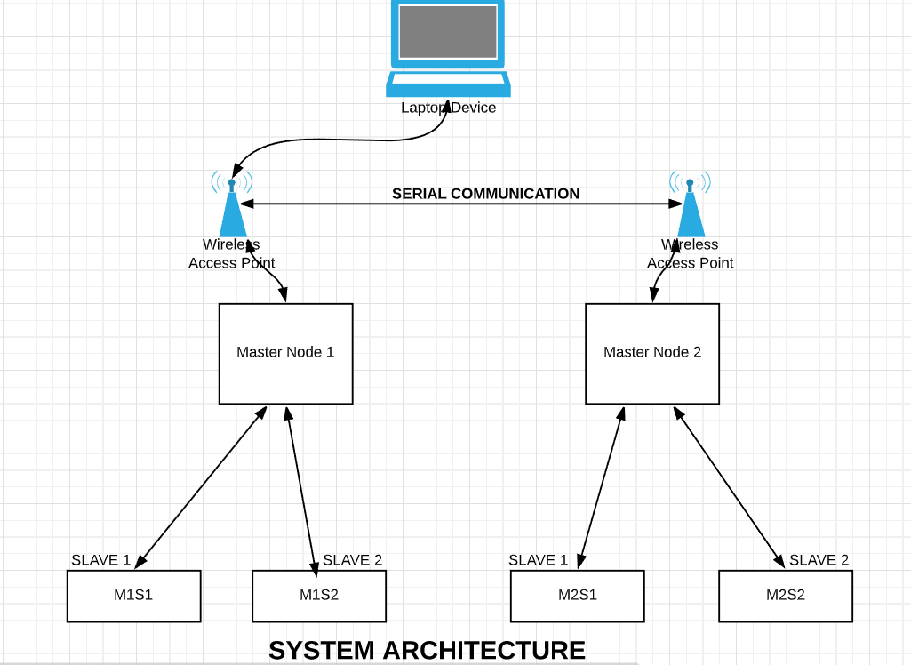
Project Architecture

Slide 7
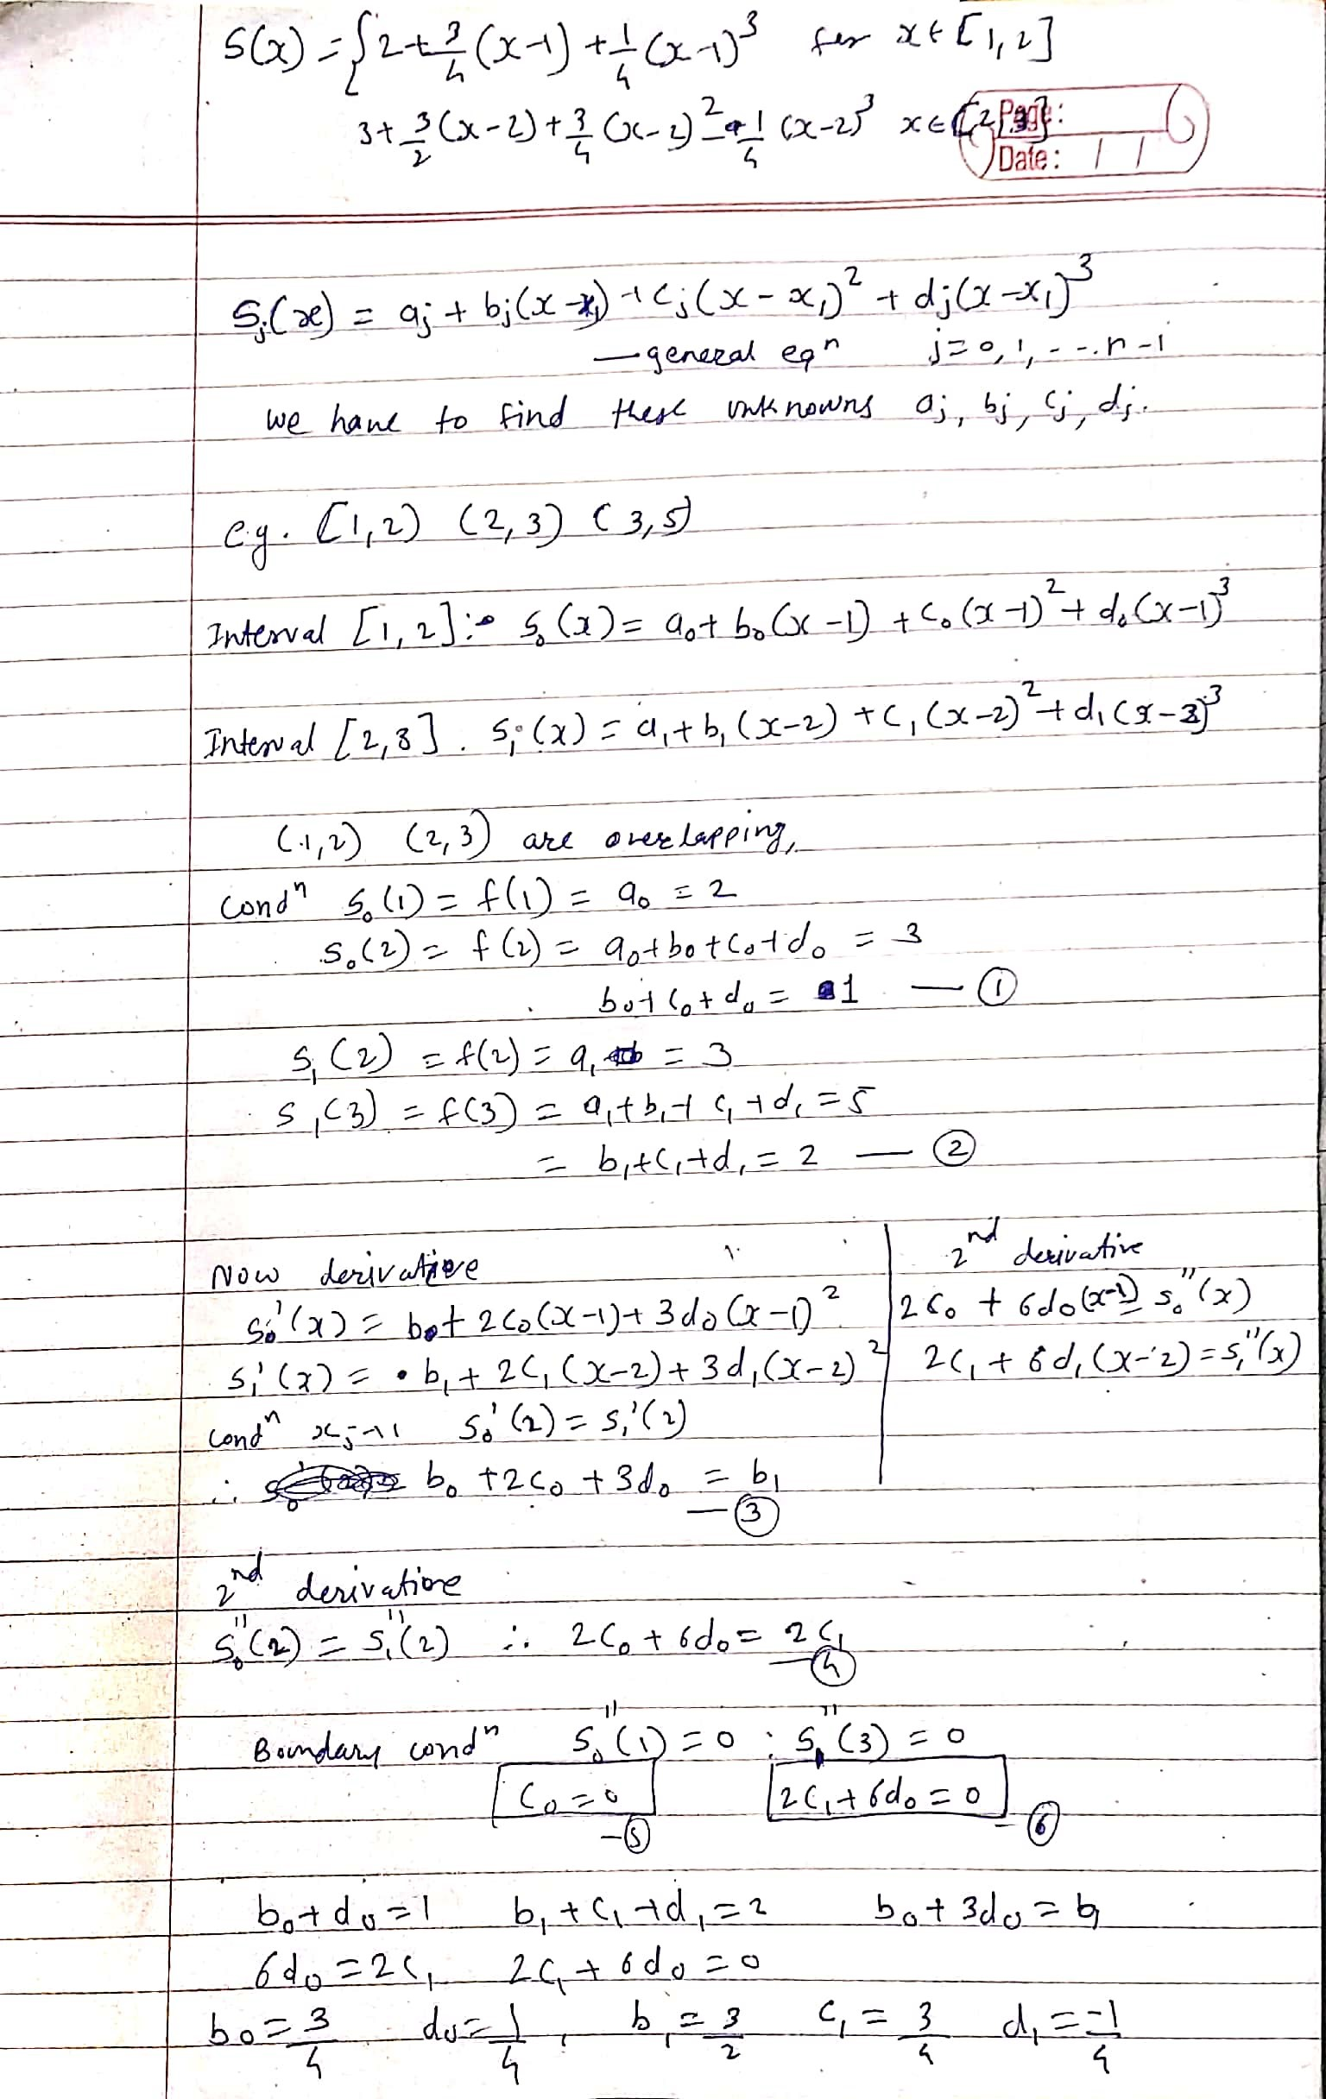
Natural Cubic Spline

Slide 8
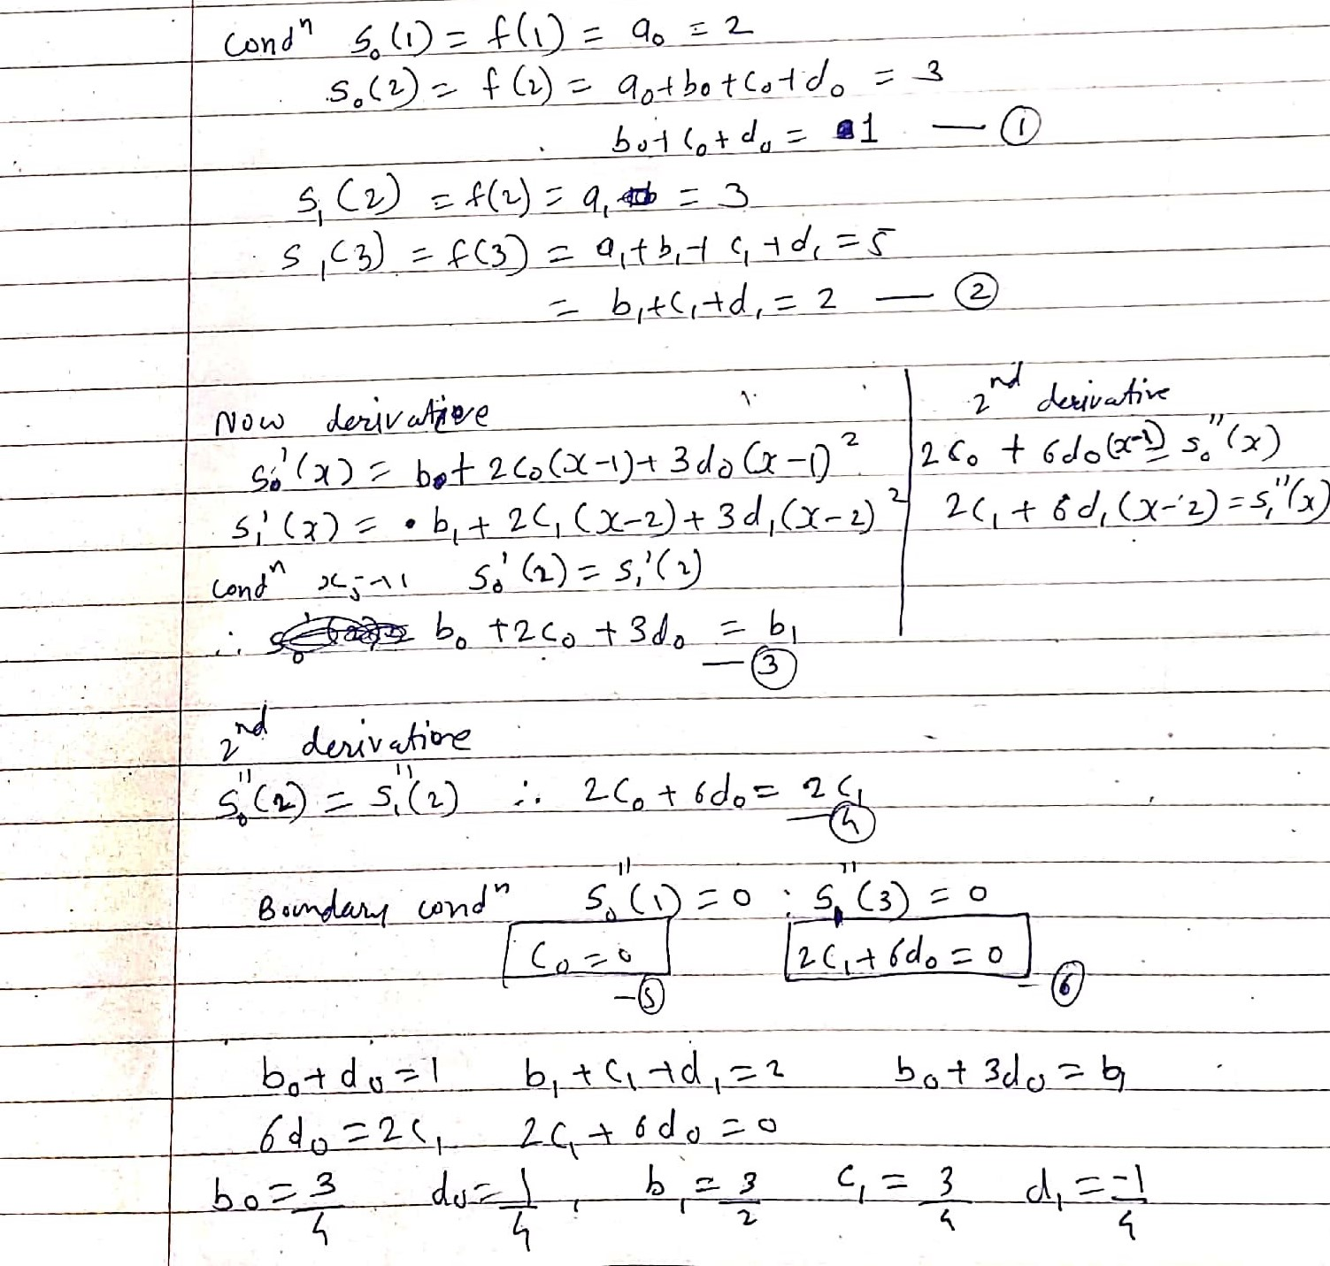

Slide 9
code completion
public CubicSpline(double y[]) {
this.y = y;
int n = y.length;
y2 = new double[n];
double u[] = new double[n];
for (int i = 1; i < n - 1; i++) {
y2[i] = -1.0 / (4.0 + y2[i - 1]);
u[i] = (6.0 * (y[i + 1] - 2.0 * y[i] + y[i - 1]) - u[i - 1]) / (4.0 + y2[i - 1]);
}
for (int i = n - 2; i >= 0; i--) {
y2[i] = y2[i] * y2[i + 1] + u[i];
}
}

Slide 10
Project Results
We are Providing the basis for calculating the required fertilizing of each crop
Evaluating the status (supply) of each nutrient element and simultaneously determine the compensation plan (nutrient management).
Providing accurate and timely diagnosis of soil fertility related problems and enables to take decision on proper nutrient management strategy.
Determining the level of availability of nutrients or the need for its introduction

Slide 11
Conclusion
Using this project user can monitor ﬁeld data from remote location.Technology in agriculture helps to improve the crop yield as well as it reduces the labor cost and time. Using Wireless Sensor Network we can make optimum use of resources and get maximum proﬁt.

Slide 12
References
1. Arpit Rawankar ; Mayurkumar Nanda ; Hemant Jadhav ; Prem Lotekar ; Rahul Pawar ; Libin Sibichan ; Akshay Pangare. Real-Time Monitoring of Soil Nutrient Analysis using WSN.Detection of N, P, K fertilizers in agricultural soil with NIR laser absorption technique. 3rd International Conference on Microwave and Photonics (ICMAP) Year: 2018.
2. Victor Grimblatt, Guillaume Ferre, Francois Rivet, Christophe Jego, Nicolas Vergara “Precision agriculture for small to medium size farmers - An IoT approach”,(IEEE) Year: 2019.
3. Koppisetti Giridhar, C. Anbuananth, N. Krishnaraj,”Research on Various Routing Techniques in Wireless Ad-hoc Networks”(IEEE), Year: 2019.
4. Marianah Masrie*, Ahmad Zahid Mohd Rosli, Rosidah Sam, Zuriati Janin and Mohd Khairi Nordin, “Integrated optical sensor for NPK Nutrient of Soil detection” 8-30 November 2018.
5. R.Sindhuja,B.Krithiga,”Soil Nutrient Identification Using Arduino”,(AJAST),Year:2018

Slide 13
Thank You…

